Slide 1
High Performance GPU-based Material Simulations in Python using Numba
By Scott Peters

Slide 2

Background
Recent Materials Science PhD graduate from RPI
Worked on Phase Field simulations of SLM melt pool solidification
Seminar will be focused on one technique used within my work: conversion of simulation to parallelized GPU code using Numba
More generally applicable and useful!

Slide 3

What is Numba?
Primarily a compiler for python code
Numba also acts as an interface for Nvidia CUDA code. Allows all coding, CPU and GPU, to be done in Python.
Faster development + High performance!
Easy to implement!
Still more work than plain Python code however
Lam, Siu Kwan, et al. “Numba: A LLVM-Based Python JIT Compiler.” Proceedings of the Second Workshop on the LLVM Compiler Infrastructure in HPC - LLVM ’15, ACM Press, 2015, pp. 1–6. DOI.org (Crossref), https://doi.org/10.1145/2833157.2833162.

Slide 4
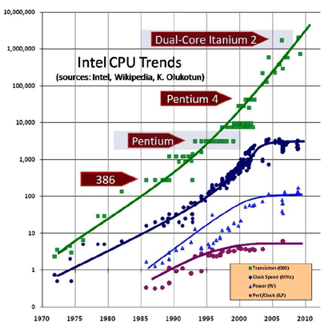
Why bother?
Transistors (x1000) Clock Speed (MHz)
Moore’s Law continues on, but clock speed has peaked.
Of the last 12 doublings (~4000x increase in transistors), the majority of this performance is locked behind parallelism
GPUs: highly parallel device, ~1000x more processing power than CPUs
Answer: in order to tap this potential 1000x speedup!
Carpentieri, Bruno. (2015). Computing beyond Moore’s law..

Slide 5
How to replicate these results
Code runs in a Jupyter Notebook using Anaconda ( https://www.anaconda.com/ )
Will require a computer with a Nvidia graphics card to run CUDA
Requires the following packages: (some may already be installed…)
numpy ( pip install numpy )
matplotlib ( pip install matplotlib )
numba ( conda install numba )
cudatoolkit ( conda install cudatoolkit )
Optional packages to run final phase field code!
pyphasefield ( pip install pyphasefield )
pycalphad ( conda install -c conda-forge pycalphad==0.8.4 )
The notebook is available at https://github.com/zhyrek/numba

Slide 6
Outline
CPU vs. GPU code
Differences between CPU and GPU code
Examples
Benchmarking
Caveats
Parallelizability
Race Conditions
Actual Materials Simulations
Diffusion
Phase Field example: Cahn-Allen
Solidification Example: Warren1995
My work

Slide 7
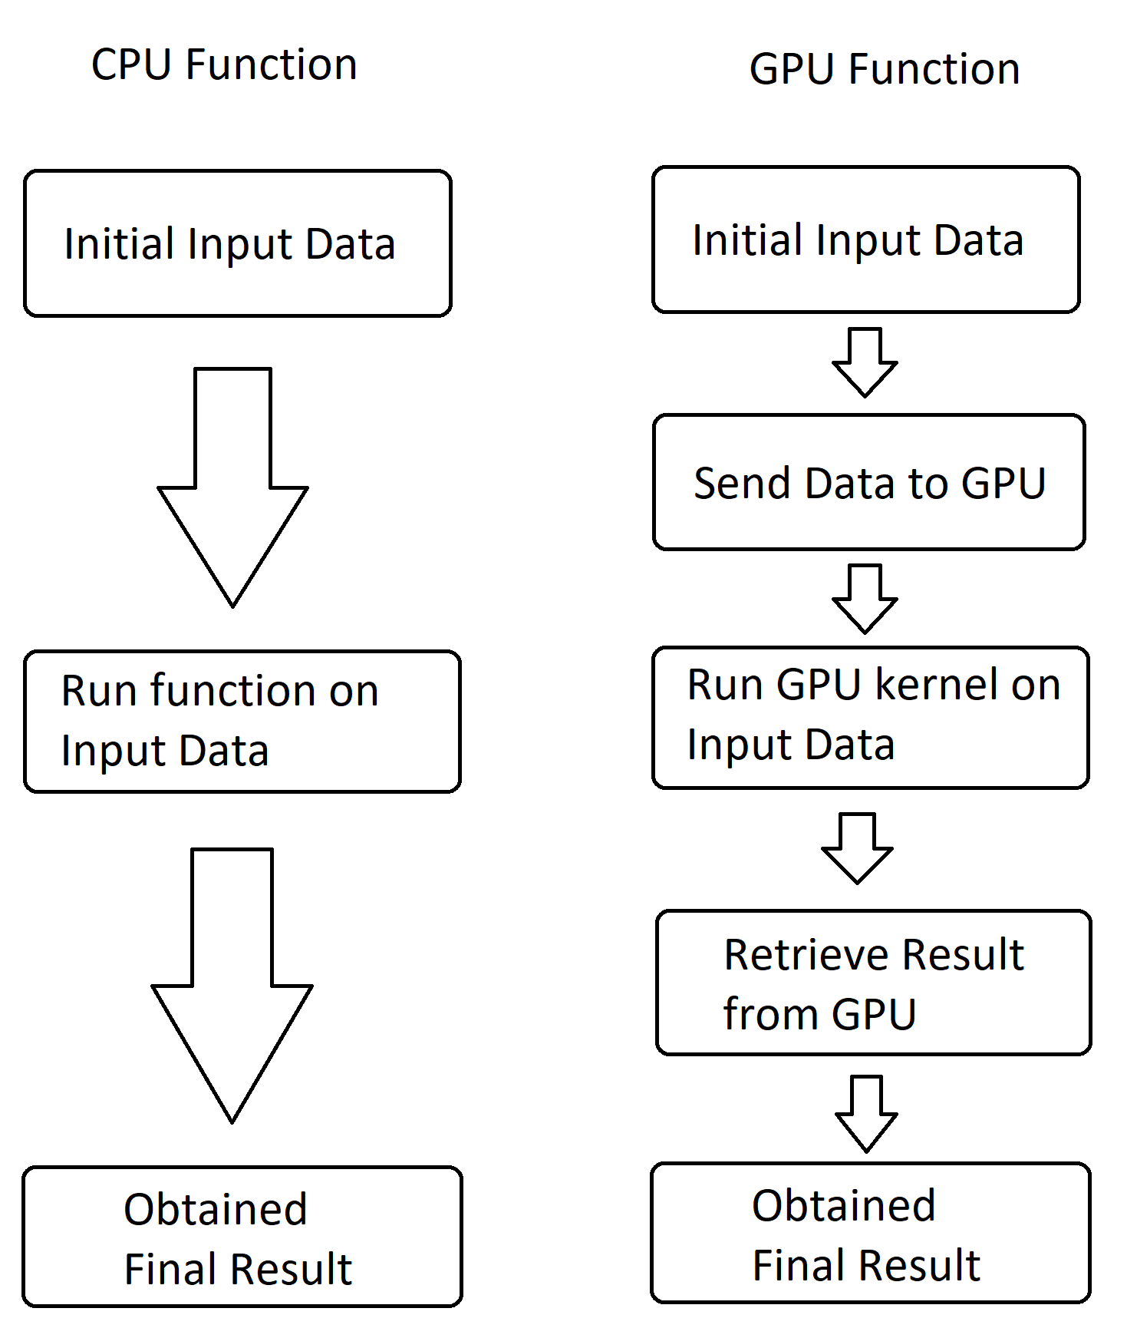
Fundamental Differences between CPU and GPU code
A GPU is its own self-contained computer, with its own memory and clock separate from the main computer (essentially, CPU).
Base python code is written for the CPU, so GPU code requires the following additional steps:
Send data to GPU
Define a kernel (~function) to run on GPU
Retrieve result from the GPU

Slide 8
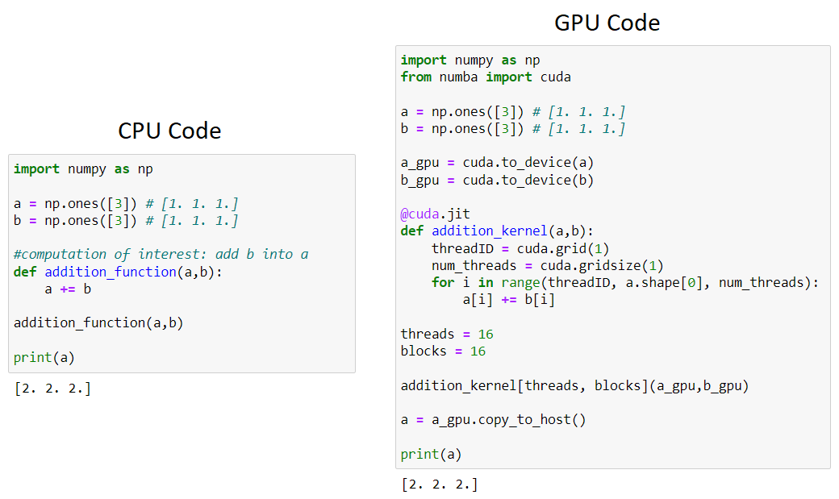
Example: Array Addition

Slide 9
Example: Array Addition
Import Numba to use CUDA
Send Data Arrays to GPU
Define CUDA Kernel
Run CUDA Kernel with
256 (16x16) parallel threads
Retrieve Result from GPU

Slide 10
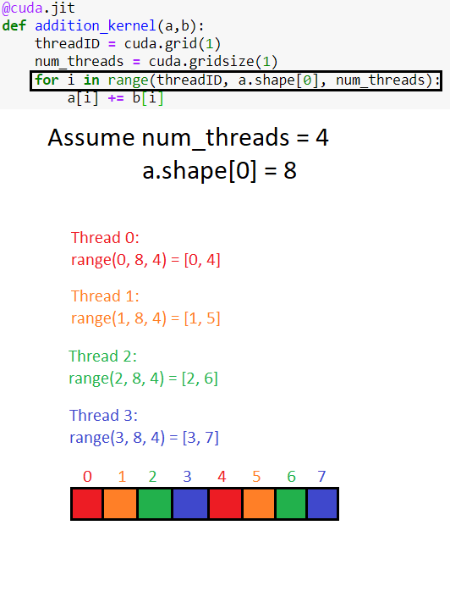
For loop in the Kernel ensures the computation of interest (here: addition) is split up evenly amongst the CUDA cores. Each thread only modifies its “color”
Should not expect any speedup as-is in the previous case: 256 threads with only 3 array indices means 253 threads are idle!
Parallelizability Aspect #1: “Are there sufficient tasks for every thread to be useful?”
What if a larger array is used?

Slide 11
Benchmarking!
Plot time it takes to add two arrays together for CPU and GPU code, with array size as the variable, ensuring the array size is larger than the number of threads (4096, in this case)!
Results:

Slide 12
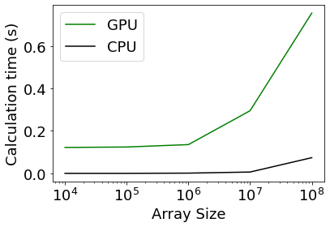
Benchmarking!
Plot time it takes to add two arrays together for CPU and GPU code, with array size as the variable, ensuring the array size is larger than the number of threads (4096, in this case)!
Results: GPU is slower.
But why?

Slide 13
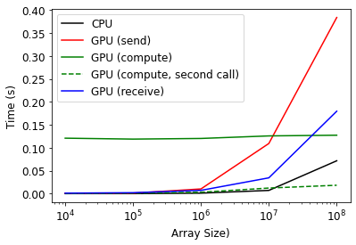
Benchmarking 2: Further Breakdown
Instead of timing the overall duration, time individual pieces of the code:
Send data to GPU
Kernel runtime
Retrieve data from GPU
Most time spent on sending/receiving data, and the compilation of the kernel.
Parallelizability Aspect #2: “Is the computation complex enough to warrant parallelizing?”
Notes:
Don’t say Electric Boogaloo here. Don’t.

Slide 14
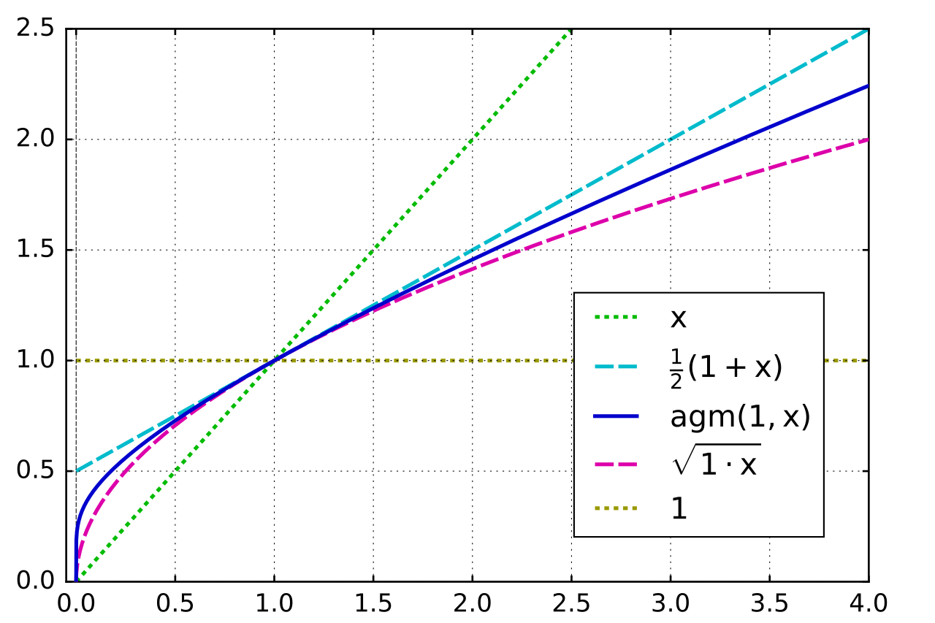
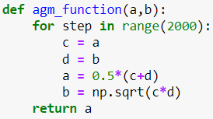
Ease of Use/Actual Speedup Example: AGM Algorithm
AGM Algorithm: choose two numbers a and b, then iterate by replacing a and b with the arithmetic and geometric means of a and b.
Toy example of algorithm with many computations, does not actually require 2000 iterations!

Slide 15
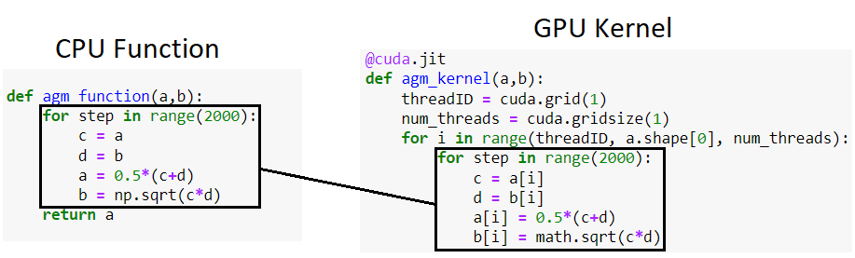
Ease of Use
Only changes are indices and use of Python math library (import math)!

Slide 16
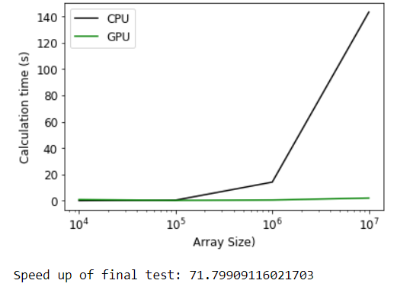
Actual Speedup
Ran AGM algorithm on 10k, 100k, 1m, and 10m pairs of data points, both on CPU and GPU code.
Even for 10m points, GPU code is still under 2 seconds, but for 10k points it takes 0.8 seconds, 20x slower than the CPU code.

Slide 17
When is it worth coding for GPU?
Good rule of thumb: assume GPU code adds one second of overhead.
Code takes less than a second to run? Not worth it.
Code takes over a second to run? GPU coding could save time!
Also consider: will you ever need to run many iterations of your code for differing parameters? Separate iterations = easily parallelizable!

Slide 18
Caveats
GPU Computing does require consideration of the following:
Limited external package functionality (e.g. np.sqrt vs. math.sqrt)
Limited base python functionality
Pre-defined array variables only
No arg/kwarg dictionaries
More info: http://numba.pydata.org/numba-doc/latest/cuda/cudapysupported.html
Race conditions

Slide 19
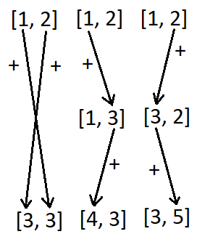
Race Conditions
Imagine an array with two values. What happens when you add the other value to each cell?
Option 1: Add both values simultaneously (vectorized CPU result, “expected” behavior)
Option 2: Add first value to second cell, then second value to first cell
Option 3: Add second value to first cell, then first value to second cell
Results vary! Must be avoided, as we cannot easily control in what order GPU threads operate!

Slide 20
Material Simulations

Slide 21
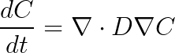
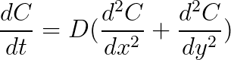
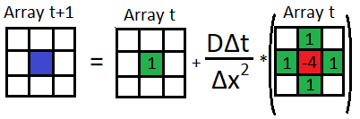
Simplest Case: Diffusion
Diffusion is the process where things move from regions of higher concentration to regions of lower concentration.
Examples:
Heat flow
Osmosis (based on water concentration)
Solute diffusion in solids
Defined by Fick’s Laws, approximated with finite difference expressions
(Will use fixed-value boundary conditions)
For 2D domain, constant D:
Using Finite Difference Approximations:

Slide 22
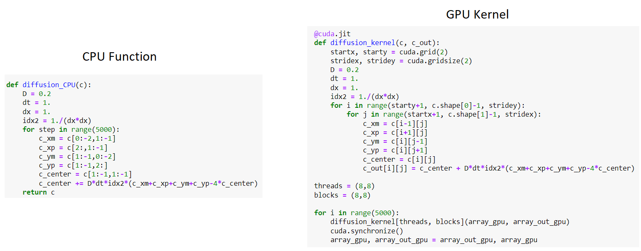
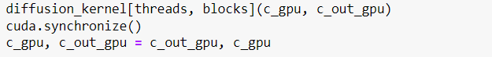
Changes:
Use of 2D indexing in GPU Kernel
Use of a second array
External loop + array switching

Slide 23
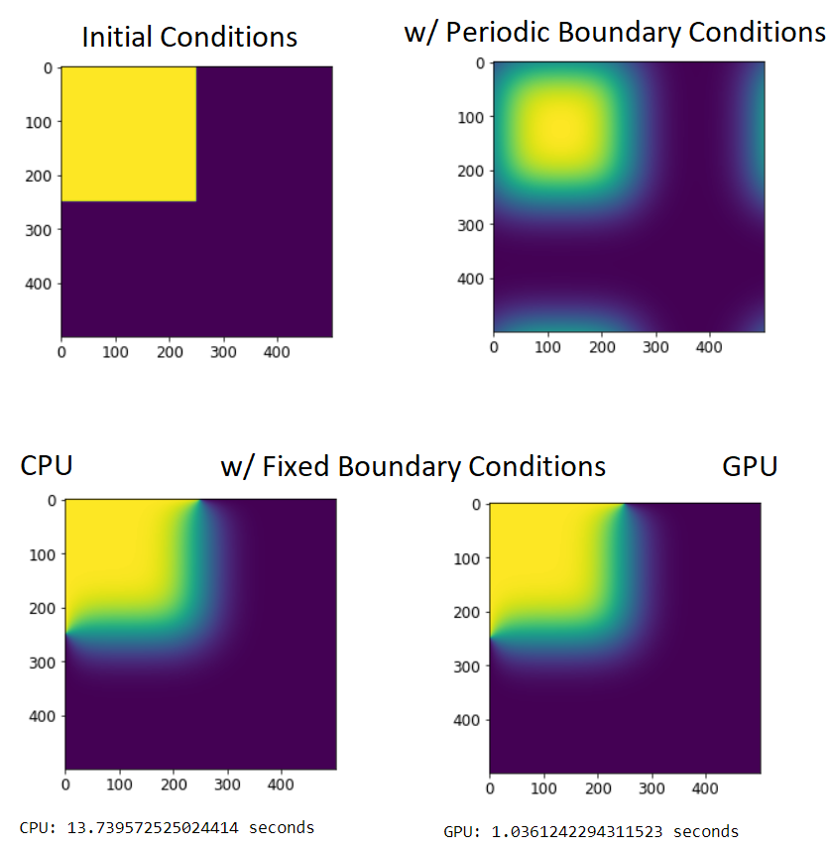
Diffusion Results
GPU is 13x faster vs. CPU.
Maximum of ~80x faster for larger simulations! (Diffusion is not particularly computationally expensive)

Slide 24
What is Phase Field?
Phase field is a class of simulations that treat phase (e.g. solid, liquid) as a continuous variable. Example:
Liquid = 0
Solid = 1
Interface between solid and liquid: ~0.5
By simulating phase as a continuous variable, movement of the interface will be automatically produced by the model, avoiding the need to manually track the interface as a crystal grows.
Simplest Phase Field model: Cahn-Allen

Slide 25
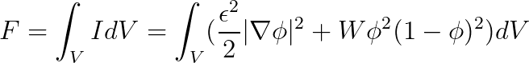
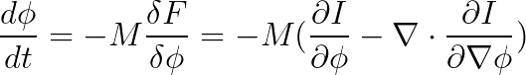
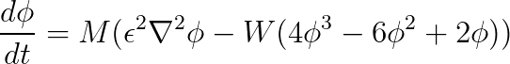
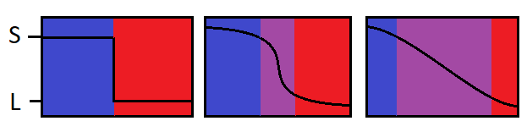
Cahn-Allen Model
Begin with a functional equation of the energy of a system, including:
Interfacial Energy (penalize sharp gradients in the phase)
Bulk Free Energy (penalize intermediate phases)
Using variational calculus, convert this into a rate equation similar to Fick’s Laws of Diffusion
Finally, use finite difference approximations to produce the final equation (not shown)

Slide 26
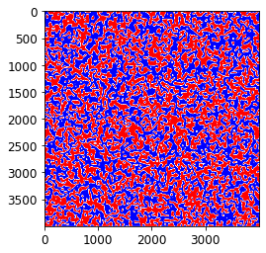
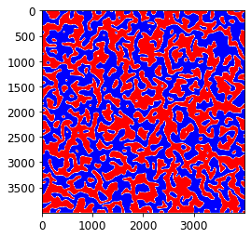
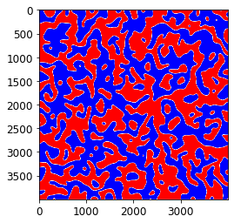
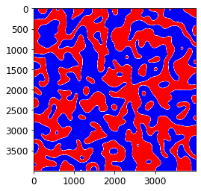
Cahn Allen Plots
Plots at 1k, 5k, 10k, 20k timesteps
Process shows smoothing of curved interfaces over time - Gibbs-Thomson Effect!

Slide 27
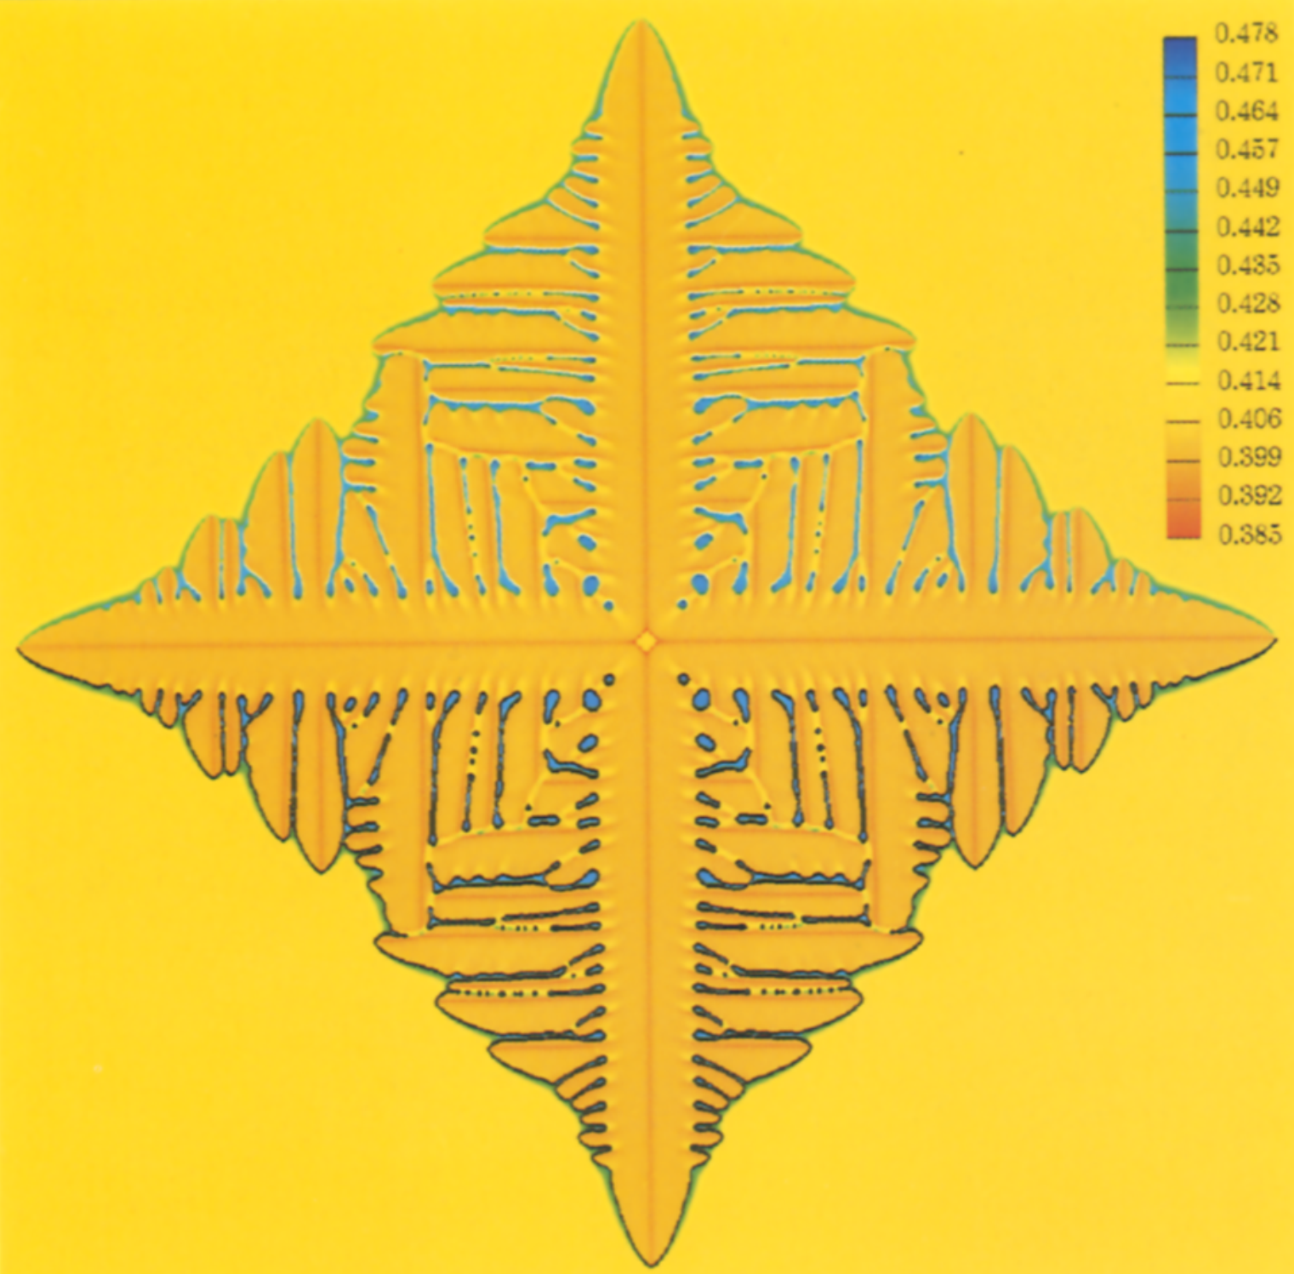
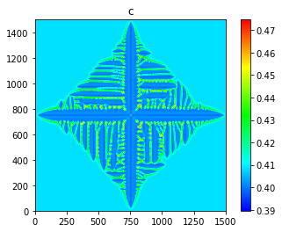
Warren1995 Model
By considering the evolution of both phase (phi) and composition (c) simultaneously, using anisotropic interfacial energy, phase field models can simulate dendritic growth!
Model is complex enough to obtain ~500x speedup using GPU. Simulation in bottom right took about 30 seconds!
Warren, J. A., and W. J. Boettinger. “Prediction of Dendritic Growth and Microsegregation Patterns in a Binary Alloy Using the Phase-Field Method.” Acta Metallurgica et Materialia, vol. 43, no. 2, Feb. 1995, pp. 689–703. DOI.org (Crossref), https://doi.org/10.1016/0956-7151(94)00285-P.

Slide 28
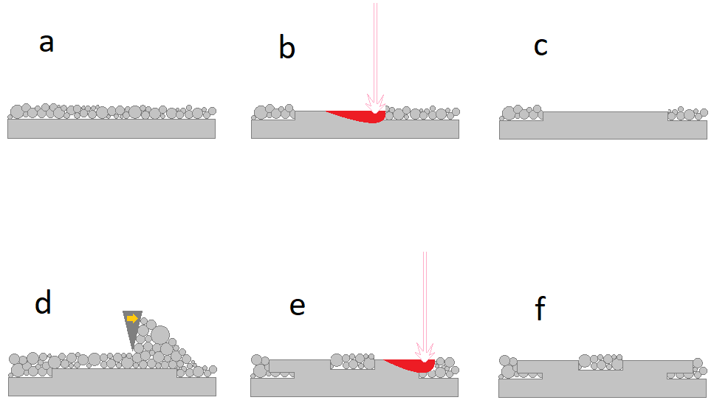
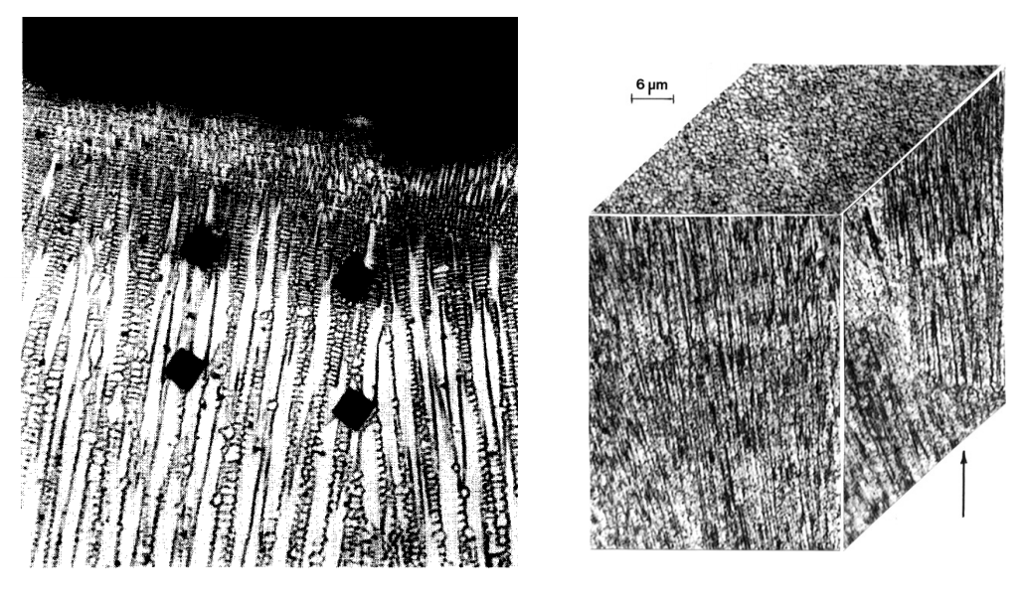
My Work - Background
Selective Laser Melting involves a laser melting metal powder into 2D consolidated layers. As more powder layers are added and melted, these layers fuse together.
As the melt pool cools, dendritic growth occurs from the outside inwards.
My work: Simulate these dendrites!

Slide 29
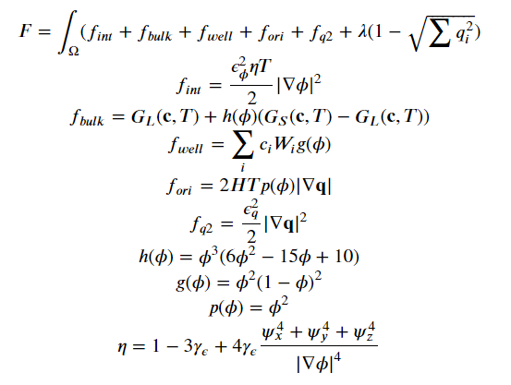
NCGPU Model
Developed a new Phase Field model with the following features:
Polycrystalline (using quaternions!)
N-component model (Inconel has many, many components!)
TDB-integration using pycalphad
GPU Acceleration

Slide 30
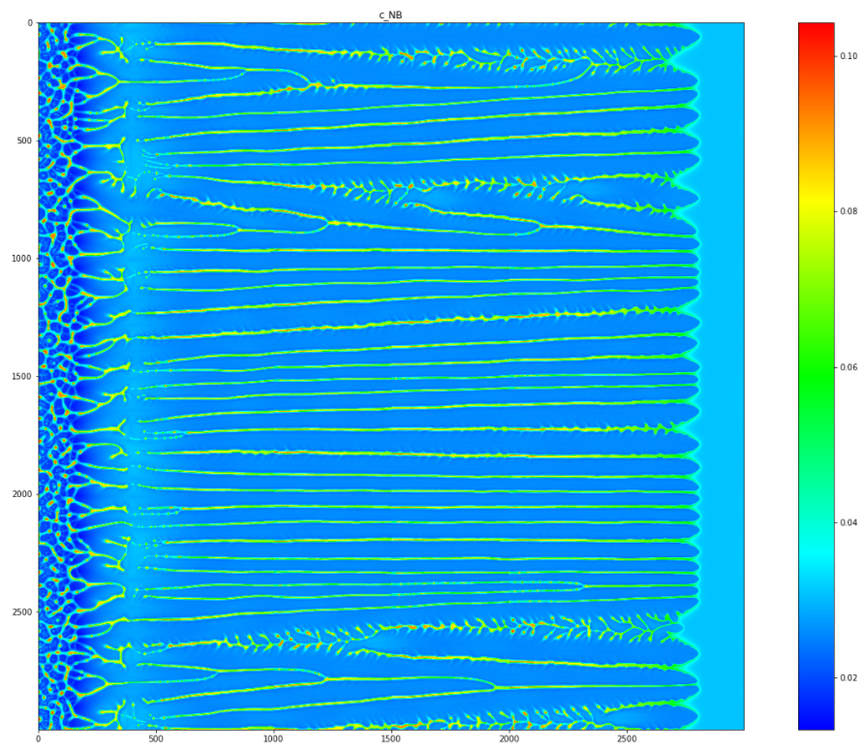
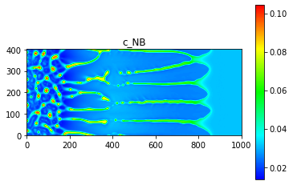
Sample Simulations
Shows 3000² dendrite simulation for G = 1.3e7 K/m, K = -1.83e6 K/s, along with a small region from it (from the Notebook!)
Results from all simulations:
Validated simulations against experimental results for PDAS (400-900 nm) in all regimes of solidification within SLM meltpool
Solute microsegregation matches for Niobium within 10%

Slide 31
Summary
GPU Parallelization will provide speedups if:
Code takes over a second to run
Code will be run many times for varying parameters
GPU Coding does require some additional considerations (race conditions, limited base python functionality), but is rather easy to implement, especially through copy/pasting pre-built kernels!
Materials from this talk available at: https://github.com/zhyrek/numba

Slide 32
Summary
GPU Parallelization will provide speedups if:
Code takes over a second to run
Code will be run many times for varying parameters
GPU Coding does require some additional considerations (race conditions, limited base python functionality), but is rather easy to implement, especially through copy/pasting pre-built kernels!
Materials from this talk available at: https://github.com/zhyrek/numba
Thanks!

